Slide 1
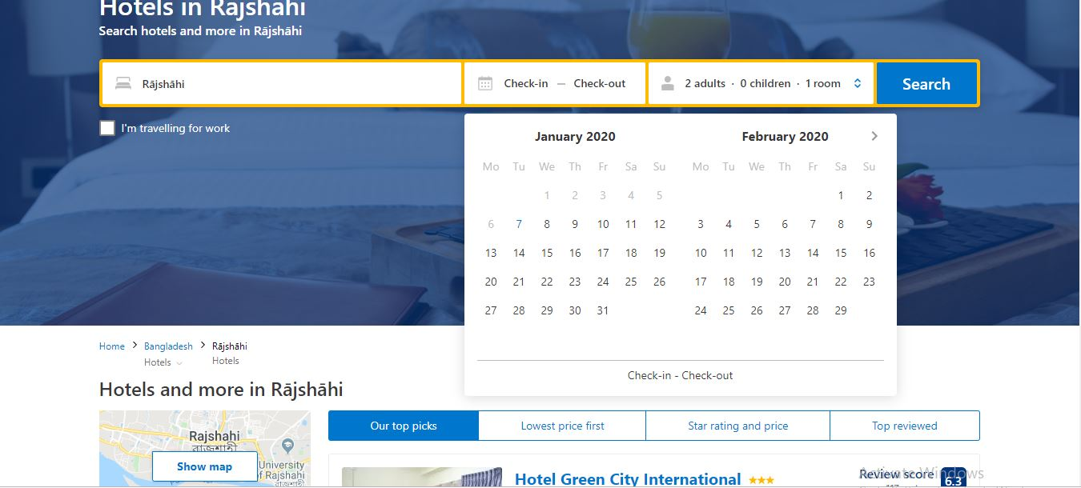
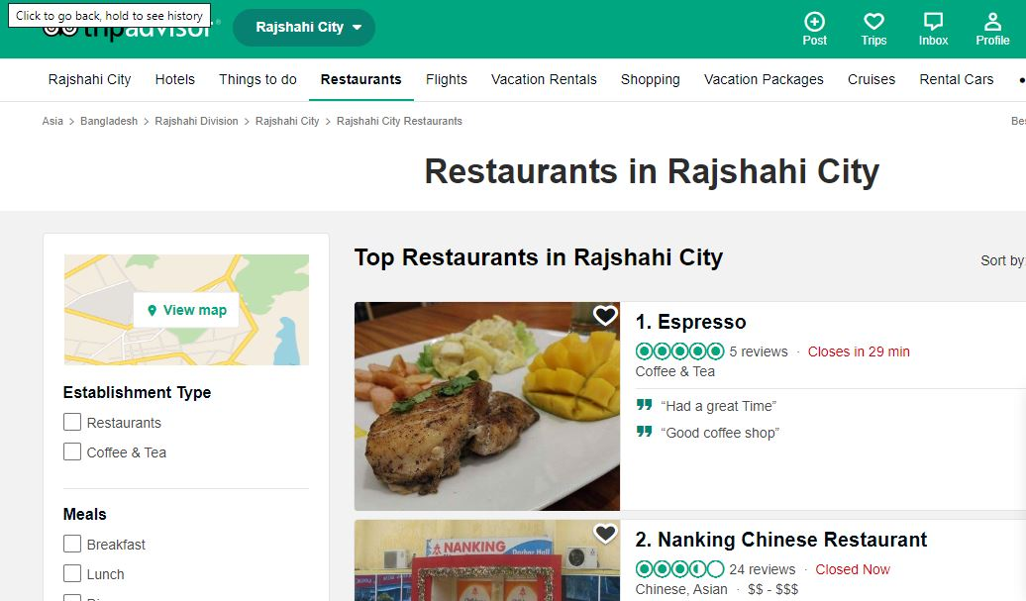
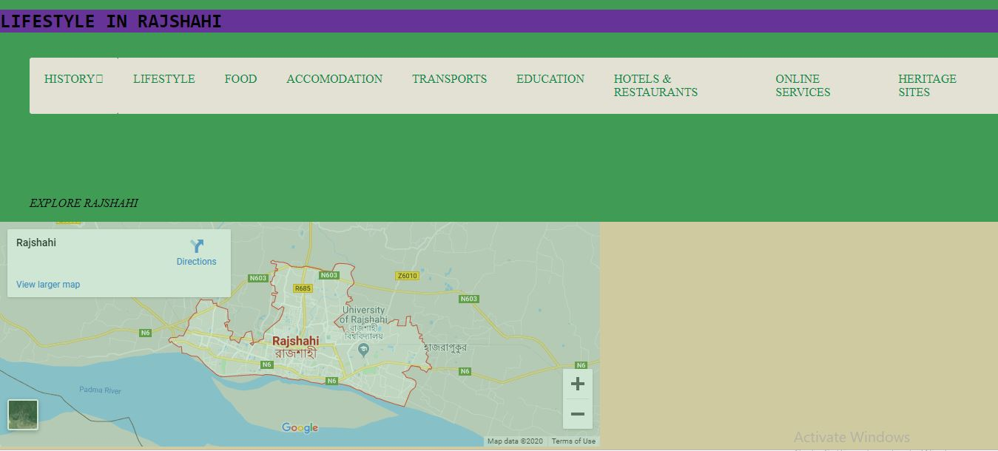
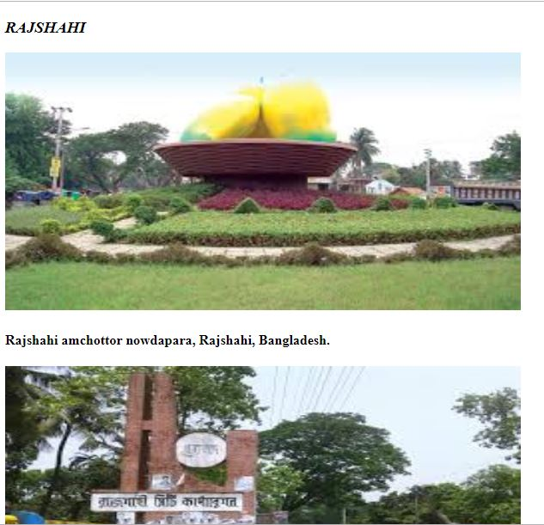
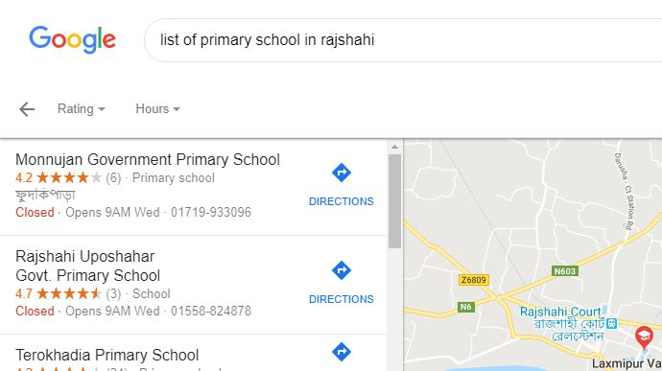
Project Rajshahi:
Features and Interface of the Website
What is this project about ?
This is an website where you can find all the information
about rajshahi. From booking a hotel to all the traditional
food of rajshahi everything is here.You can explore the
Whole rajshahi through this page.
Equipment needed for the project
Operating System (Windows 10)
Visual Studio Code as Editor
Django 2.0.2 as Web Framework
HTML, CSS, JavaScript etc as the
programming languages for Coding and designing
stuff.
People want to visit rajshahi can have a look and will be easier for them to explore this
city.
Local people can get all the info here.
Tourist can visit this page and know about the famous places , traditional food of rajshahi.
Anyone can geolocate places in rajshahi.
Know about educational places in rajshahi.
Zarin Rafa Prapti
1603044

